Slide 1
FSharp FTCF (For the Checkered Flag)
Jamie Dixon
Open Sharp
9/29/2017

Slide 2
Agenda
Domain/Problem Statement
Experiment
Code
Results
Questions

Slide 3
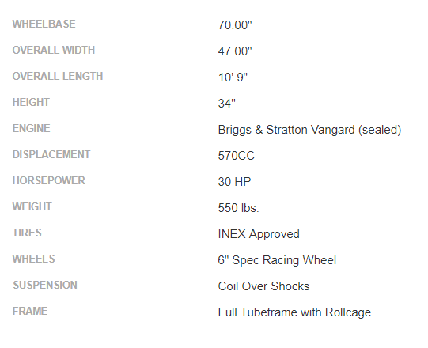
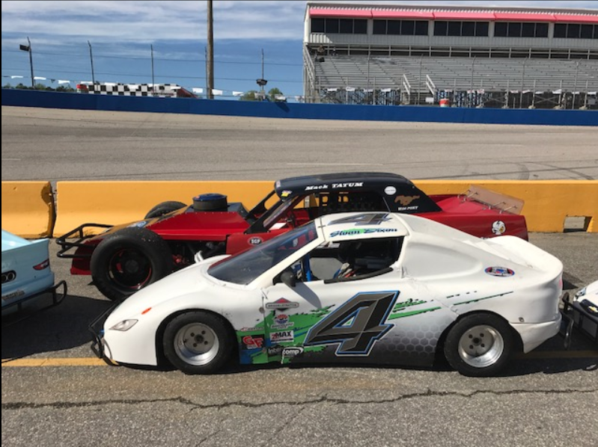
Domain

Slide 4
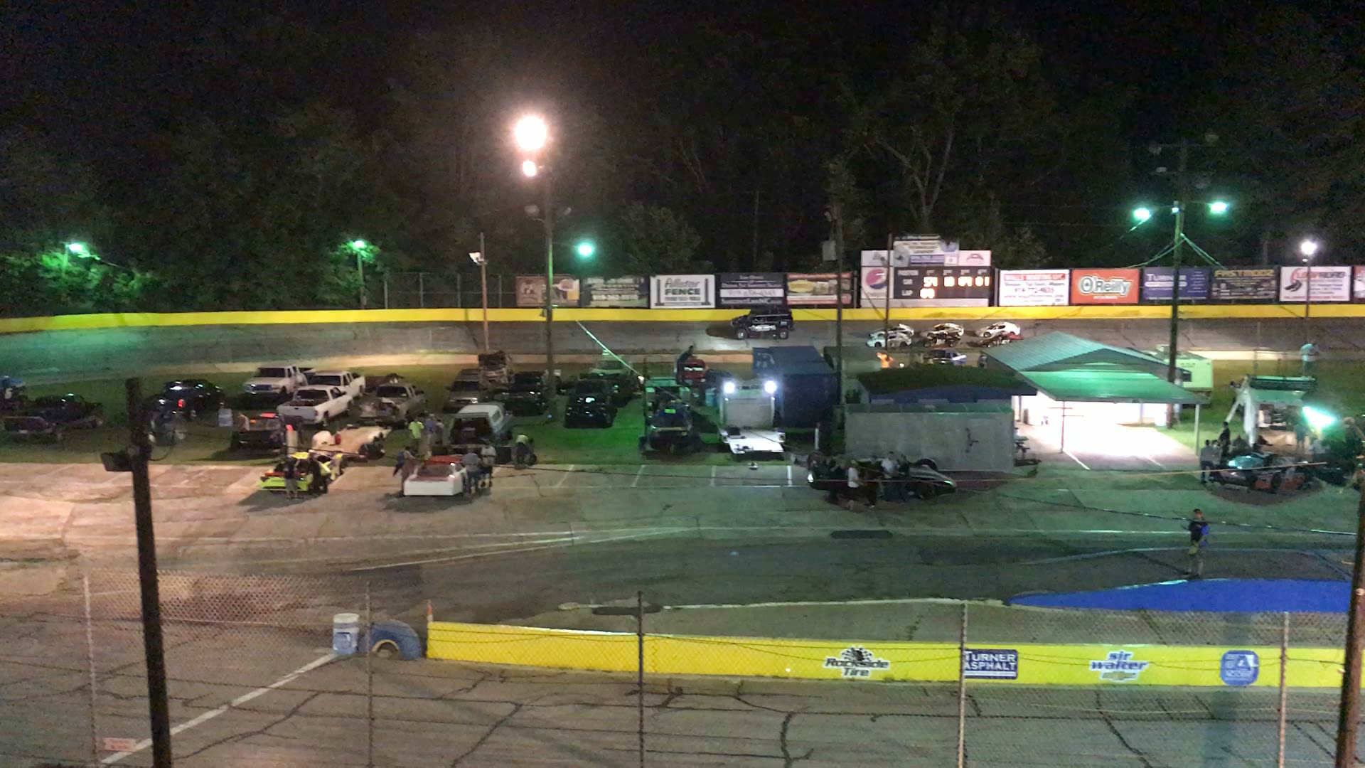
Problem Statement

Slide 5
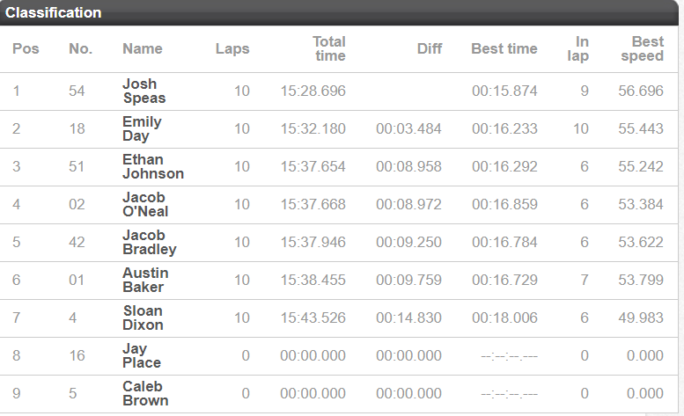
Problem Statement

Slide 6
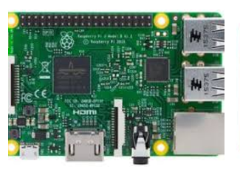
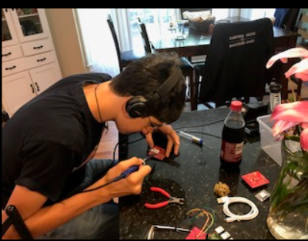

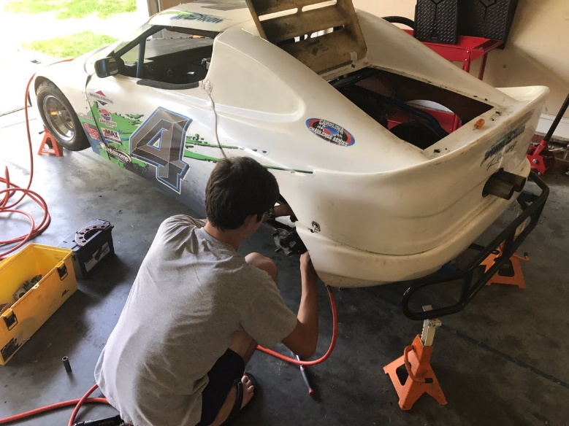
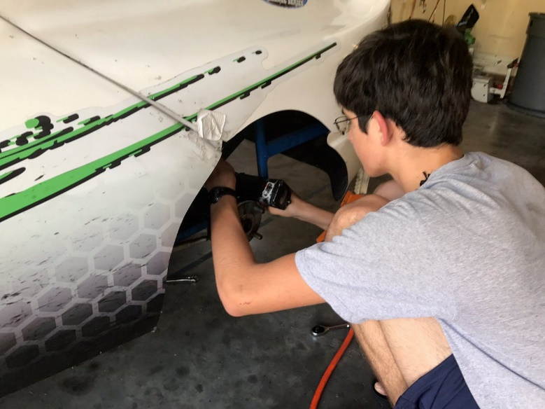
Experiment

Slide 7
Code: Python

Slide 8
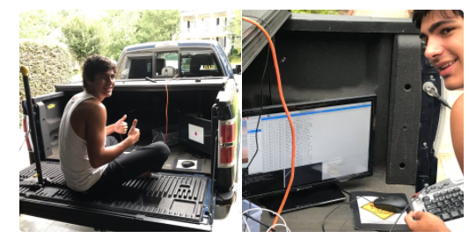
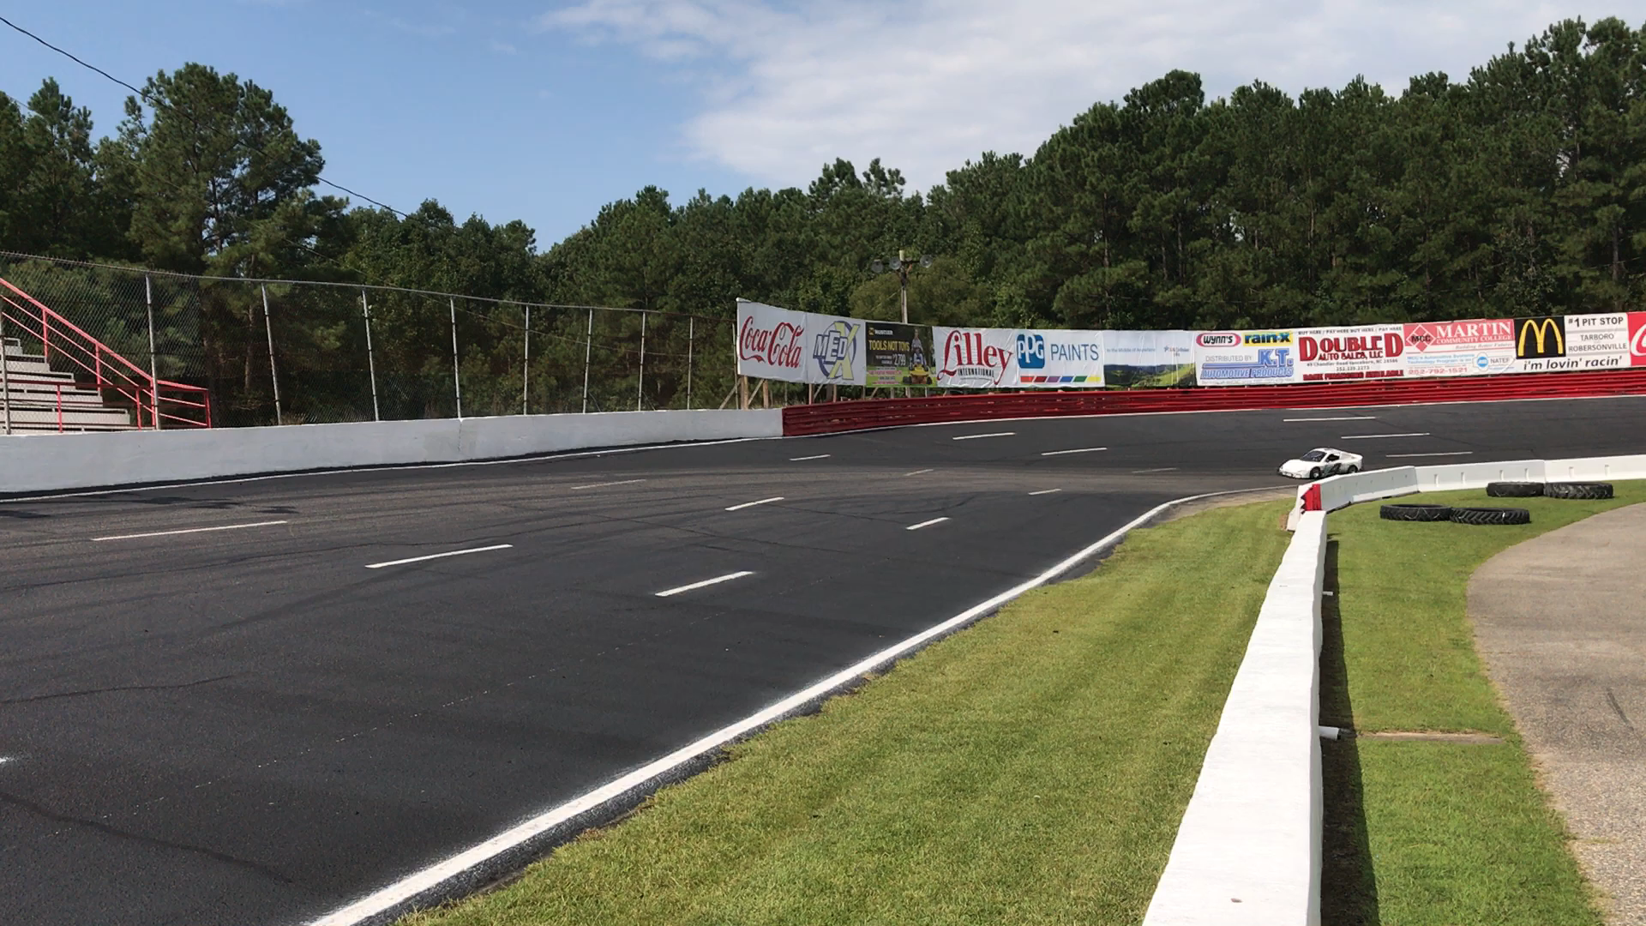
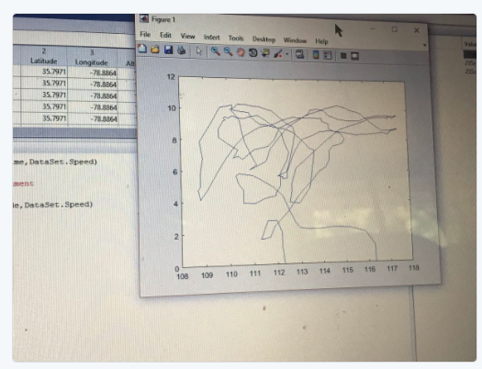
Experiment

Slide 9
Code: F#

Slide 10
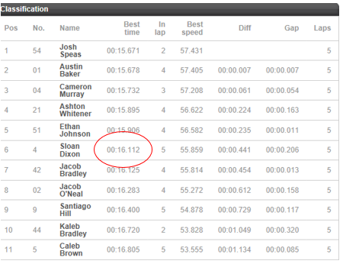
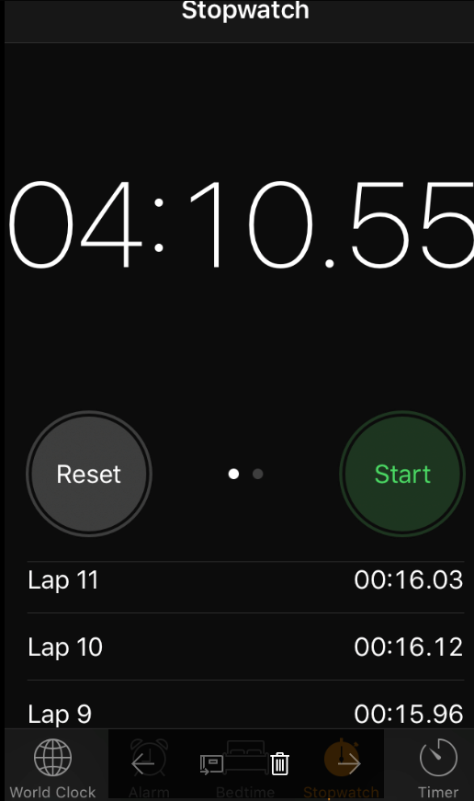
Results

Slide 11
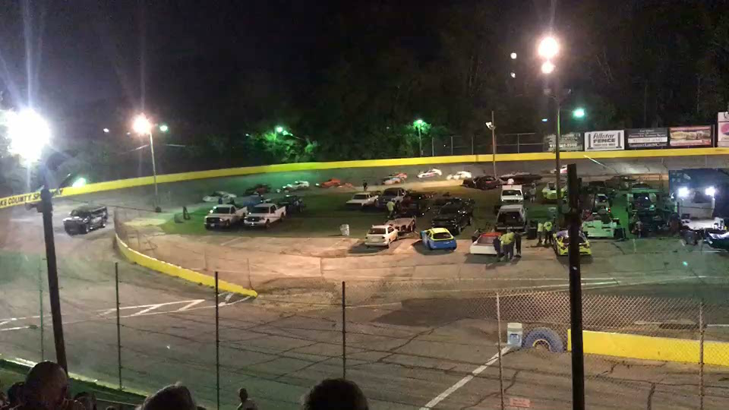
Results

Slide 12
Questions?
http://www.uslegendcars.com/
http://www.wcspeedway.com/
https://twitter.com/Sloan4Racing
http://fsharp.org/
https://github.com/jamessdixon/openfsharp
https://twitter.com/jamie_dixon

